Slide 1
CST 499 Final Project
By Corey Schultz
University of Arizona Global Campus
CST499: Capstone for Computer Software Technology
Dr. Charmelia Butler
October 23, 2023

Slide 2
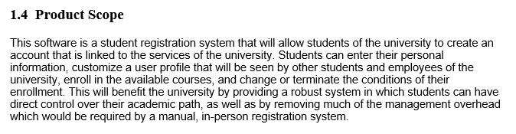
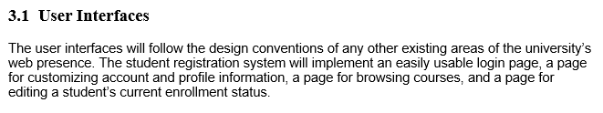
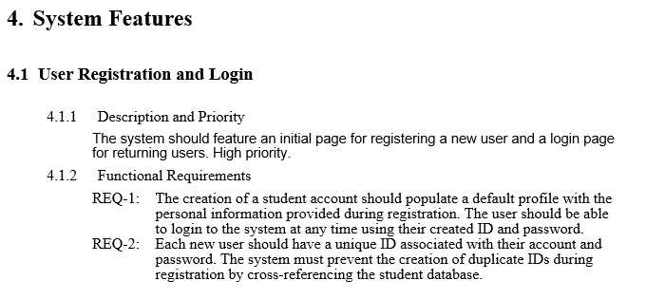
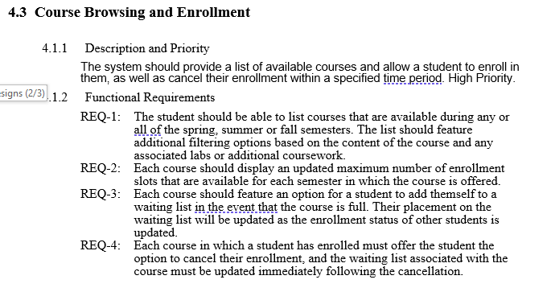
Software Requirements Specification Key Aspects

Slide 3
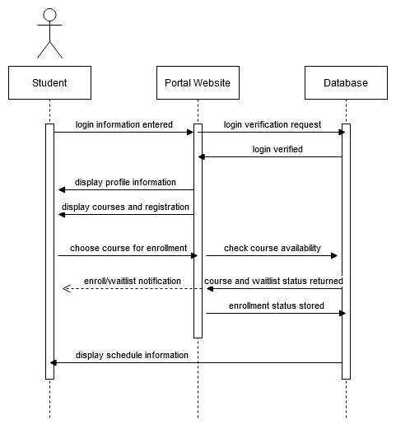
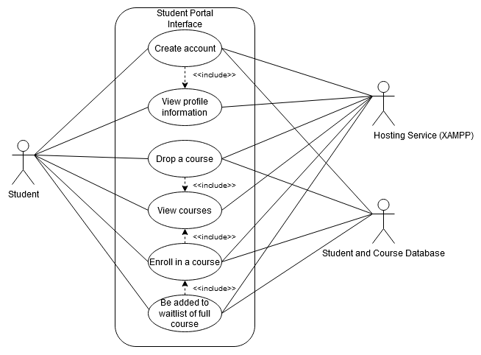
UML Designs (1/3)
Use Case Diagram
Sequence Diagram

Slide 4
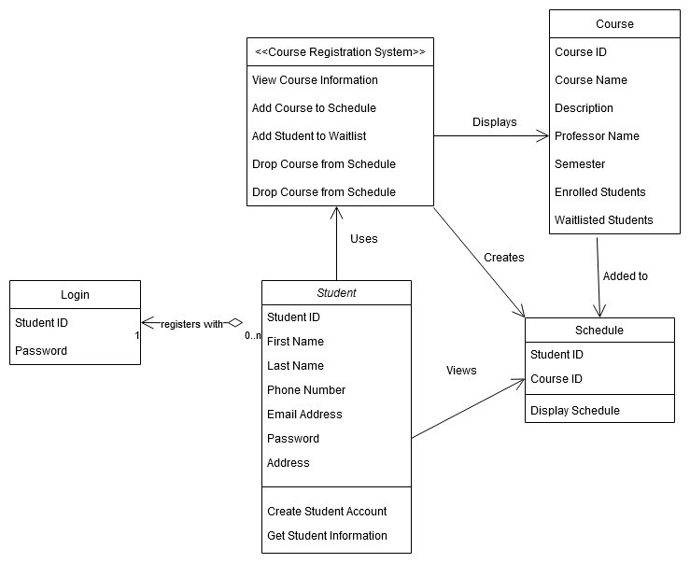
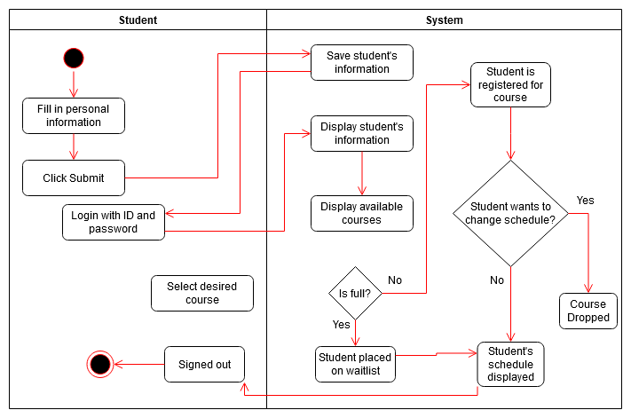
UML Designs (2/3)
Activity Diagram
Class Diagram

Slide 5
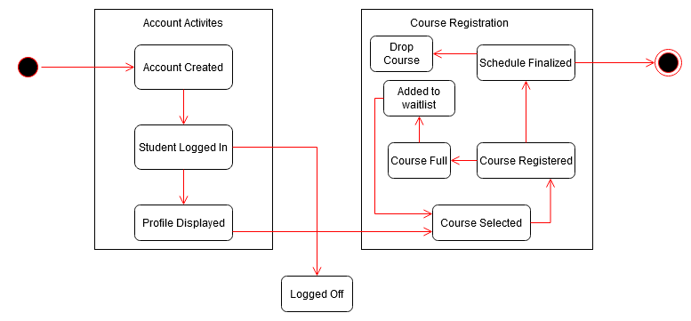
UML Designs (3/3)
State Diagram

Slide 6
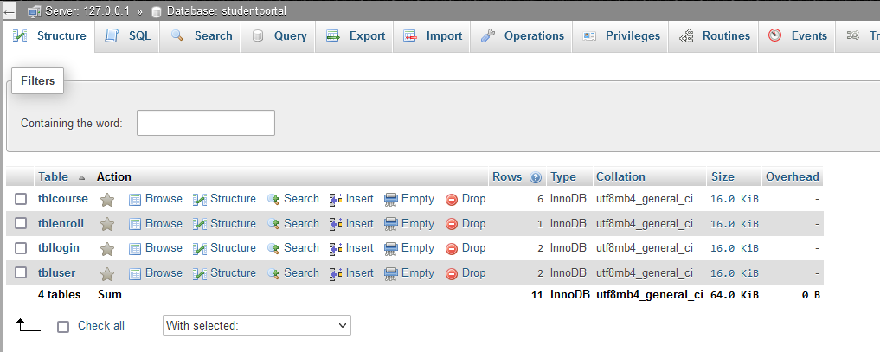
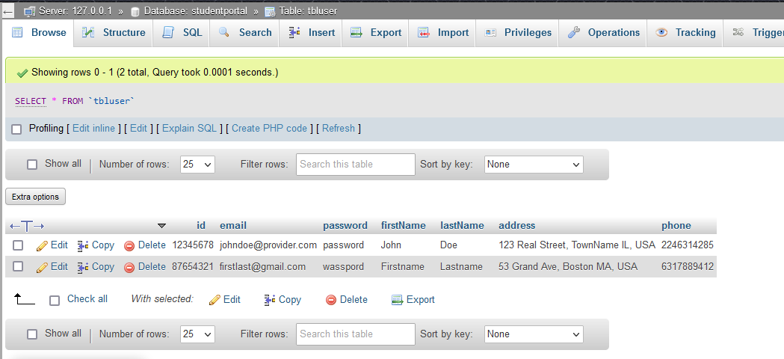
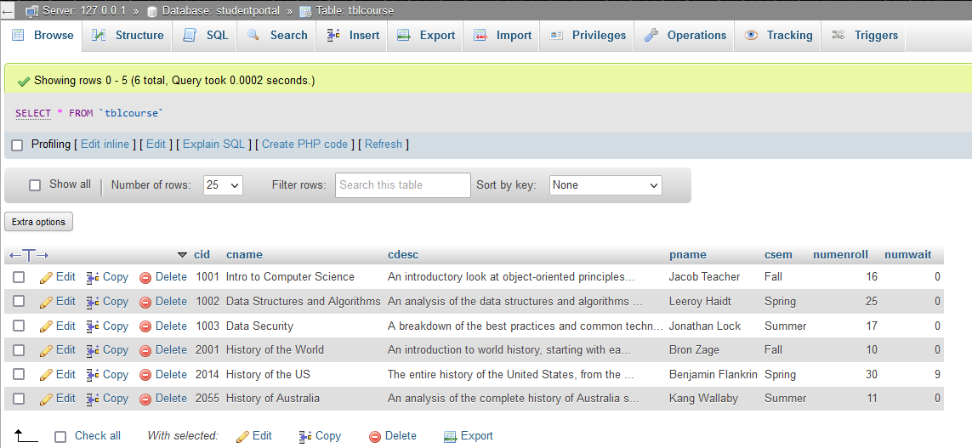
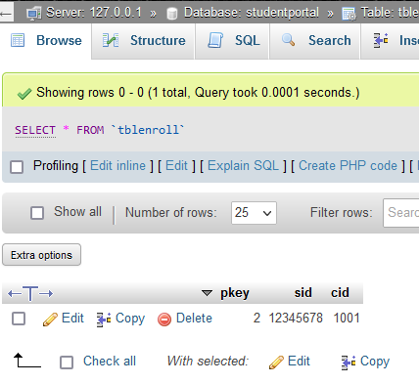
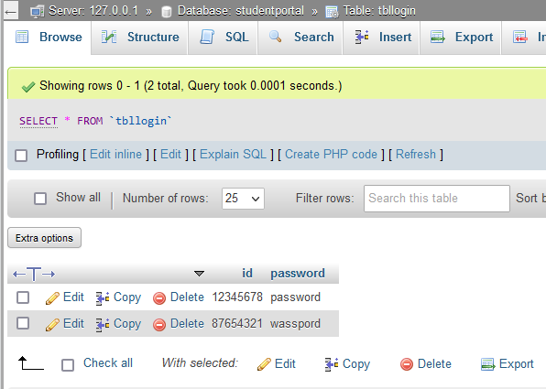
Student Portal Design: Database

Slide 7
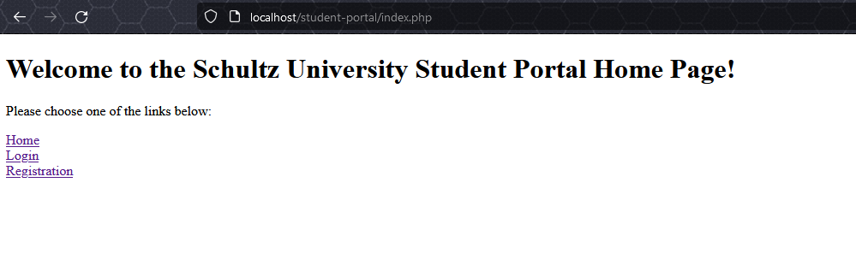
Student Portal Design: Landing Page
Modern, sleek, minimalist style
The “Home” link in the footer redirects to this page

Slide 8
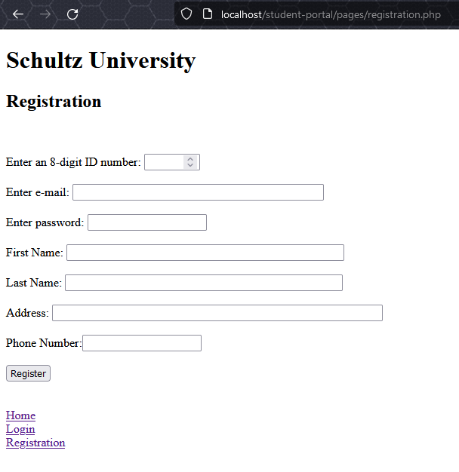
Student Portal Design: Enrollment Page
ID number is the primary key to avoid students using the same ID
All fields except for ID and password are VARCHARs, even phone number, since it won’t be used for any calculations

Slide 9
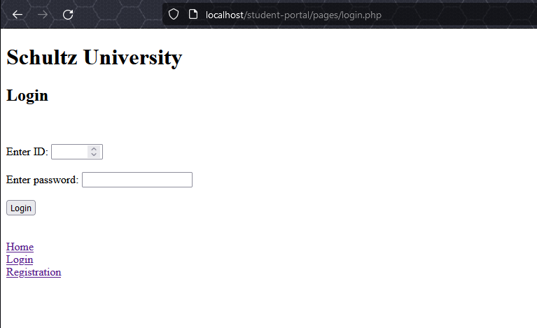
Student Portal Design: Login Page
HTML form with two entry fields
First is of type “number”
Second is of type “password”
“Submit” button checks value against tblLogin

Slide 10
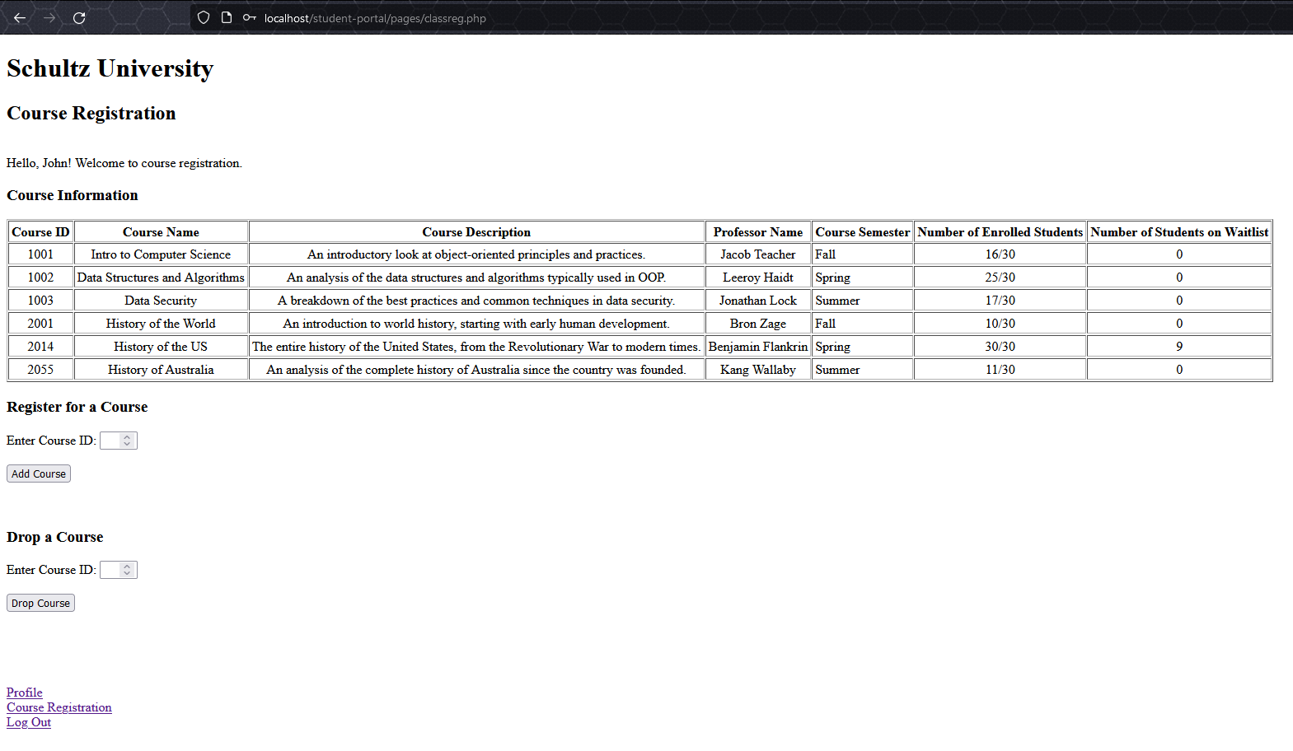
Student Portal Design: Course Registration Page
Greets the user and shows an HTML table of all available courses
Can refresh the page to see the “Number of Enrolled Students” field increment or decrement when a course is added or dropped, respectively

Slide 11
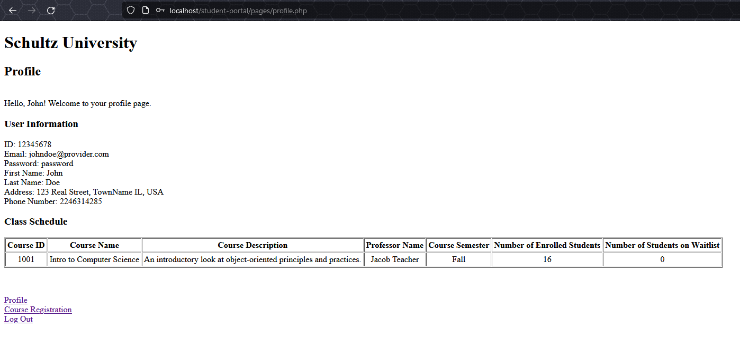
Student Portal Design: Student Profile Page
One section for displaying general user information, another for all the courses in which a student has enrolled
Rest assured that Schultz University has strict security measures in place to protect your password, despite displaying it in plaintext here

Slide 12
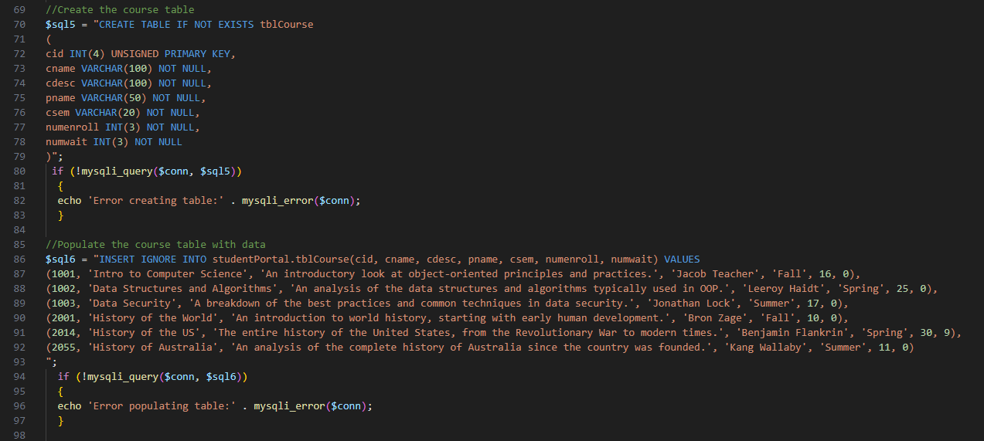
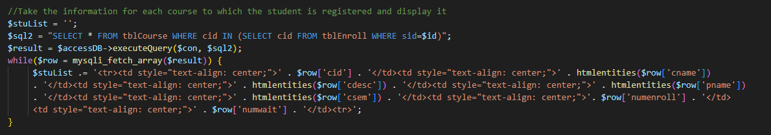
Student Portal Design: Code Highlights
(Top Image) Used the “INSERT IGNORE” statement to avoid creating duplicate data on page reload
(Bottom Image) Used a nested SELECT statement to gather course information where the course ID is linked with Student ID in tblEnroll

Slide 13
References
Adams, D. (2023). How to Sort Table Columns with PHP and MySQL. CodeShack. https://codeshack.io/how-to-sort-table-columns-php-mysql/
Connolly, R., & Hoar, R. (2018). Fundamentals of web development (2nd ed.). Pearson.
Fakhroutdinov, K. (n.d.). The Unified Modeling Language. UML Diagrams - overview, reference, and examples. Retrieved from https://www.uml-diagrams.org/
Geelen, P. & Vuk, A. (2018). SQL Server commands - DML, DDL, DCL, TCL. TechNet. Retrieved from https://social.technet.microsoft.com/wiki/contents/articles/34477.sql-server-commands-dml-ddl-dcl-tcl.aspx
Krüger, G., & Lane, C. (2023, January 17). How to Write a Software Requirements Specification (SRS Document). Perforce Software. https://www.perforce.com/blog/alm/how-write-software-requirements-specification-srs-document
Tsui, F., Karam, O., & Bernal, B. (2018). Essentials of software engineering (4th ed.). Jones & Bartlett Learning.
Wiegers, K. E. (1999). Software requirement specifications for <project> [Template]. https://web.cs.dal.ca/~hawkey/3130/srs_template-ieee.doc

